Slide 1
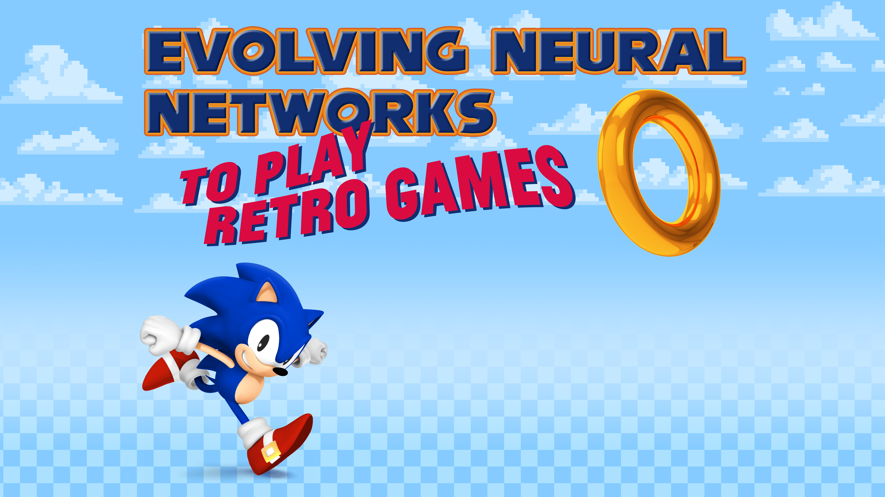
John McMeen
Computer and Information Sciences
Northeast State Community College

Slide 2

Overview
Machine Learning
Why Retro Games?
Open AI Gym Retro
NEAT
Code Review

Slide 3
Machine Learning
Computer algorithms that learn through experience
Artificial intelligence
Model data through training or sample data
Supervised, unsupervised, reinforcement learning

Slide 4
Why Retro Games?
Many existing problems
Created without bias
Simple decision-based mechanisms
ALL YOUR FUN ARE BELONG TO US!

Slide 5
Open AI Gym Retro
Open source, many existing game integrations
Creates emulated game environment with game loop
Adds functionality to examine emulator RAM (memory)

Slide 6
NEAT
Neuroevolution of augmenting topologies
Genetic algorithm which evolves neural network structure
Dr. Ken Stanley in 2002 while at The University of Texas at Austin
NEAT Python

Slide 7
Code Review
Originally released by Lucas Thompson
https://www.youtube.com/playlist?list=PLTWFMbPFsvz3CeozHfeuJIXWAJMkPtAdS
https://gitlab.com/lucasrthompson/Sonic-Bot-In-OpenAI-and-NEAT
Cleaned up and documented
Github: https://github.com/jmcmeen/novus-retro.git

Slide 8
Future Work
Northeast State Technologies Division Data Center Integration
Adapt existing work to all games in personal Sega ROM Library
Develop new integrations for Open AI Gym Retro
Host in house AI competitions
Create simulation editor GUI

Slide 9
Questions
jnmcmeen@northeaststate.edu
Find Me in Lab T243! Northeast State Technologies Building
Cave/Office: T219

Slide 10
Sources
Evolving Neural Networks through Augmenting Topologies - http://nn.cs.utexas.edu/downloads/papers/stanley.ec02.pdf
NEAT-Python - https://neat-python.readthedocs.io/en/latest/
Lucas Thompson Sonic Bot - https://gitlab.com/lucasrthompson/Sonic-Bot-In-OpenAI-and-NEAT

